Slide 1
Gen AI – LLM Learning
Topics Learned So Far
Conventional AI vs Gen AI
Deep Learning – Transformer Architecture
LLM Models – Frontier or Foundational (Closed) Models vs Open-Source Models
Prompting Technics – Shot Prompting (Zero, one-shot, few-shots), Multi step , Chain of Thought (CoT), Tree of Thought (ToT), Self-Consistency, Meta Promptings
HuggingFace Open-Source Platform - Details
LLM Calling Methods – Chat Interfaces, CLI Commands, API Invocations using Python Coding
LLM Models Selection – Leader Boards & Various Performance Metrics
First LLM Call – CLI Command using Ollama.
LLM API Keys setup for OpenAI, Anthropic, Google, DeepSeek
Cursor IDE vs Claude Code for LLM Coding
Cursor IDE , UV Python Package Manager setup for LLM Coding
LLM calls via APIs – Using Closed vs Open-Source Models API Keys
LLM Inferencing vs Fine Tuning – Details Explained
LLM Coding for Inference Tasks such as Text Summarization Projects – Web Summarizer, Brochure build for a company
Build User Interfaces using Gradio – Implementing Web Summarizer, Brochure build projects via Gradio
Build Your First Conversational AI Chatbot – Adding history, context/prompt enrichment, Prompt Chaining
Adding Resources to LLM call and Evaluating by an another LLM

Slide 2
Gen AI – LLM Learning
Topics Learned So Far
18. Multi Modality – Generate an image from text, Image to text reasoning, Text to Speech
19. Build your second Conversational AI Chatbot – Airlines Assistant System using Multi Modality
20. Tools Usage – Basic Function call, API Calls, Database Retrievals
Upcoming Topics
21. RAG (Retrieval-Augmented Generation) Retrievals
22. Inference tasks using Open-Source Models such as Text Summarization, Text Classifications, Sentiment Analysis, Image Generation, Text to Audio conversion etc
23. Implementing your AI Agents or Projects into HuggingFace Open-source platform
22. Fine Tunning LLM Models using Frontier or Closed Source Models
23. Fine Tunning LLM Models using Open-Source Models
24. AI Agents vs Agentic AI Frameworks
25. Agentic AI – No Framework. Only Pythonic Way!!
26. Agentic AI – Using OpenAI Agents SDK
27. Agentic AI – Using Crew AI
28. Agentic AI – Using LangChain, LangGraph, LangSmith
29. Agentic AI – Using Microsoft Autogen
30. Agentic AI – MCP (Multi Context Protocol) Servers
31. Agentic AI – A2A (Agent to Agent)
32. More real-time use cases – More Coding for domain specific AI Use cases
33. Transformer Architecture – Deep Dive

Slide 3
Deep Learning
🧠 What is Deep Learning?
Deep Learning is like teaching a computer brain (called a neural network) how to recognize patterns.
It’s called deep because it has many layers stacked on top of each other.
📊 Example:
You show it many cat pictures.
The first layer learns simple things (lines, colors).
The middle layers learn parts (ears, tails).
The last layer says: “Yes, this is a cat!”
🖼️ Simple
Input → Hidden Layers → Output
(image) (detect features) (cat or not?) Neural Network Flo
🧠 Deep Learning (Big Picture)
Deep Learning = using neural networks with many layers to learn patterns.
It is the foundation on which special models like BERT and GPT are built.
It’s like:
Deep Learning = “Electricity”
BERT & GPT = “Appliances running on electricity.”

Slide 4
BERT vs. Language Models (Simplified)
📚 What is BERT?
BERT = Bidirectional Encoder Representations from Transformers
It reads text both ways (left-to-right and right-to-left).
Purpose: understand text deeply.
BERT is like a reader – it’s very good at understanding text, but not great at generating long answers.
Example tasks:
“Is this review positive or negative?”
“What is the meaning of this word in context?”
Input Sentence → BERT → Understanding / Classification
💬 What are Language Models (LMs)?
Language Models try to predict the next word in a sentence.
Example: “New York is a big …” → “city”
GPT (Generative Pretrained Transformer) is a generative language model.
LMs are like a writer – very good at generating new text, stories, or answers.
Input Sentence → LM → Next word / Full text
BERT = A careful reader
(understands meaning of each word in a paragraph)
GPT = A creative writer
(can continue the story and generate paragraphs)

Slide 5
BERT vs. Language Models (Simplified)
Feature | BERT (Reader) | Language Models (GPT etc.) (Writer)
Direction | Reads both ways (left + right) | Reads forward only (left → right)
Main Use | Understanding, classification, Q&A (short answers) | Text generation, conversation, writing
Strength | Very good at understanding context | Very good at creating fluent text
Output style | Labels, embeddings, short answers | Long-form text, stories, essays
Example Task | “Is this spam?” → Yes/No | “Write me a poem about cats”
✅ In summary:
Deep Learning = the base technology.
BERT = deep-learning transformer that is great at understanding.
Language Models (like GPT) = deep-learning transformers that are great at generating.

Slide 6
Transformer Architecture-Simplified
🔑 Transformer Architecture (the model behind ChatGPT & LLMs)
Transformers are special deep learning models designed to understand language.
They became popular because they can read, understand, and generate text really well.
🖼️ Transformer Flow (Simplified)
🧠 Example Sentence
We’ll use a very simple input sentence:
👉 “Cats are cute.”
We’ll see how this sentence travels through the Transformer pipeline until we get the final output (like predicting the next word).
🔹 Step 1: Input & Tokenization
Computers don’t understand words, so we first break the sentence into tokens (small units).
Example:
" Cats are cute." → ["Cats", "are", "cute", "."]
Each word is then mapped to a number (an ID from the vocabulary).
🔹 Step 2: Embedding Layer
Each token ID is converted into a vector (a list of numbers) that captures meaning.
Example:
"Cats" → [0.21, -0.11, 0.98, ...]
"are" → [-0.34, 0.75, 0.56, ...]
"cute" → [0.89, 0.12, -0.45, ...]
Now, words are represented in a way the model can understand.

Slide 7
Transformer Architecture-Simplified
🔹 Step 3: Positional Encoding
Transformers don’t know order by default.
So, we add position info (1st word, 2nd word, etc.) into embeddings.
Example:
"Cats" + Position(1) → vector A
"are" + Position(2) → vector B
"cute" + Position(3) → vector C
This ensures the model knows the difference between “Cats are cute” and “Cute are cats”.
🔹 Step 4: Self-Attention
✨ This is the magic of Transformers. Each word looks at all other words and decides how much attention to give them.
Example:
For “are”:
pays attention to “Cats” (subject)
pays attention to “cute” (description)
So the model learns:
"Cats" ↔ "are" ↔ "cute“
Word → looks at all → weighted connections → richer meaning

Slide 8
Transformer Architecture-Simplified
🔹 Step 5: Multi-Head Attention
Instead of one way of looking, the model uses many “heads” (different perspectives).
Example:
Head 1: Focuses on grammar (subject–verb).
Head 2: Focuses on meaning (cats ↔ cute).
Head 3: Focuses on position/order.
Then, all heads are combined into a better representation.
🔹 Step 6: Feed-Forward Network
After attention, each token vector passes through a small neural network.
This helps transform information into a form useful for prediction.
Example:
"are" → refined meaning: “verb linking subject and adjective”
🔹 Step 7: Layer Normalization + Residuals
To keep training stable, outputs are normalized (scaled neatly).
Residual connections make sure we don’t lose the original info.
Think of it as cleaning and balancing the signals before moving forward.
🔹 Step 8: Stacking Layers
Transformers don’t just do this once.
They repeat attention + feed-forward multiple times (e.g., 12, 24, 48 layers).
With each layer, understanding becomes deeper and richer.
Example:
Lower layers: Learn words (“Cats”, “cute”).
Middle layers: Learn grammar (subject, predicate).
Higher layers: Learn meaning of full sentence.

Slide 9
Transformer Architecture-Simplified
🔹 Step 9: Output Layer (Prediction)
Finally, the model tries to predict the next word.
Example: Input: “Cats are cute”
Model checks context and predicts → “animals”, “pets”, etc.
🖼️ End-to-End Flow
Input: "Cats are cute."
1. Tokenization → ["Cats", "are", "cute", "."]
2. Embeddings → Vectors for each word
3. Positional Enc. → Add order info
4. Self-Attention → Words look at each other
5. Multi-Head Attn. → Different perspectives
6. Feed-Forward Net → Refine meaning
7. Normalization → Balance signals
8. Stacked Layers → Deep understanding
9. Output Layer → Predicts "animals"
✅ In Summary
Transformers process text step by step.
They first turn words into numbers (embeddings) + add order info.
Then, through attention, each word looks at all others.
Multiple layers gradually build deep understanding.
Finally, the output layer predicts the next word or answer.

Slide 10
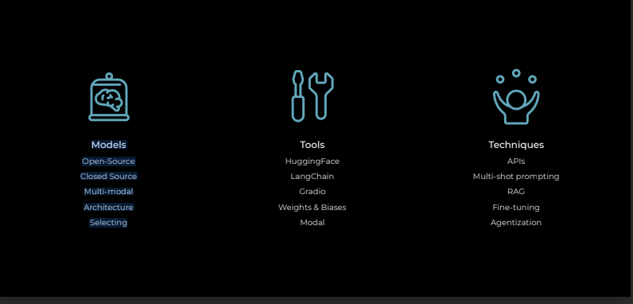
3 Dimensions of LLM Engineering

Slide 11
Gen AI Models – Closed vs Open Source LLM Models
🧠 What are AI Models?
AI Models are like engines that power applications such as ChatGPT, Claude, or LLaMA.
There are two kinds of models available:
Frontier / Foundational (Closed) Models
Open-Source Models
🔒 Frontier / Foundational (Closed) Models
Built by big companies like OpenAI (ChatGPT), Anthropic (Claude), Google (Gemini).
Called closed because:
We cannot see their inside details (architecture, training data).
We only access them through an API or app.
They are like a finished car: you can drive it, but you cannot open the engine or change parts.
Strengths: Very powerful, state-of-the-art, usually more reliable.
Limitations: Expensive, less customizable, no full transparency.
Popular Frontier/Foundational (Closed) Models:
GPT-5 (Latest)/ GPT-4 / GPT-4o / GPT-4o mini → OpenAI (ChatGPT)
Claude 3 Family (Haiku, Sonnet, Opus) → Anthropic
Gemini 1.5 Pro / Flash → Google DeepMind
Perplexity
Copilot Model Family → Microsoft
Command R+ → Cohere (some parts closed)
Amazon Titan → AWS

Slide 12
Gen AI Models – Closed vs Open Source LLM Models
🌍 Open-Source Models
Built by communities or companies and released openly (Meta’s LLaMA, Mistral, HuggingFace models).
Called open because:
Anyone can download the model.
You can study how it works.
You can modify or fine-tune it for your needs.
They are like a bike you can assemble yourself: you can add parts, adjust, and even build your own version.
Strengths: Free/cheaper, customizable, transparent.
Limitations: May need more setup, sometimes less powerful than closed models.
Popular Open-Source Models: (There are 1 Lakh open models available in HuggingFace)
LLaMA 2 / LLaMA 3 → Meta AI
Mistral 7B / Mixtral (MoE) → Mistral AI
Qwen – Ali Baba cloud (Chinese)
Falcon → Technology Innovation Institute (TII, UAE)
Gemma → Google (open-weight models)
Phi-3 → Microsoft
Pythia → EleutherAI
Dolly → Databricks
RedPajama → Together.ai + community

Slide 13
Gen AI Models – Closed vs Open Source LLM Models
✅ In short:
Closed → Big tech, very powerful, pay-to-use, not customizable.
Open-Source → Community-driven, free/cheaper, customizable, you can run them locally.
Feature | Frontier/Closed Models 🚗 | Open-Source Models 🚲
Who builds them? | Big tech companies | Community + companies
Access | API only (black box) | Download + run yourself
Transparency | Hidden | Open (you can inspect)
Customization | Limited | Highly customizable
Cost | Usually paid | Often free or cheaper
Example | GPT-4, Claude, Gemini | LLaMA, Mistral, Falcon

Slide 14
Gen AI Models –LLM vs SLM Models
SLMs (Small Language Models) → Best for real-time, cost-sensitive, private, and domain-specific industry applications.
LLMs (Large Language Models) → Best for broad, knowledge-rich, creative, and complex reasoning tasks.
🧩 SLM vs. LLM in Real-Time Industry Applications
Aspect | Small Language Models (SLMs) | Large Language Models (LLMs)
Performance / Latency | 🚀 Very fast, low latency, suitable for real-time apps (fraud alerts, chatbots, IVR systems). | ⏳ Slower response, especially if cloud-hosted; may not meet real-time needs.
Compute & Cost | 💰 Runs on edge devices or modest servers; low infra & energy costs. | 💸 Requires high-end GPUs/TPUs and large clusters; expensive to scale.
Deployment | 🌍 Can run offline on devices, in-prem data centers, or IoT/embedded systems. | ☁️ Mostly cloud-based, needs powerful infra; harder to deploy locally.
Data Privacy & Compliance | 🔒 Data stays within enterprise/edge devices → ideal for regulated industries (finance, healthcare, govt). | 🌐 Data often goes to external servers; compliance & privacy risks.
Customization | 🛠️ Easier & cheaper to fine-tune for domain-specific use (medical, legal, retail, etc.). | 🎯 Fine-tuning possible but costly, resource-heavy, and slow.
Knowledge Breadth | 📉 Limited world knowledge, may struggle with very broad/general queries. | 🌐 Broad knowledge across domains; excels in general-purpose Q&A.
Scalability | ✅ Scales easily across thousands of edge devices with low cost. | ❌ Scaling requires significant infra; not feasible for massive edge rollouts.
Energy & Sustainability | 🌱 Energy-efficient, aligns with green AI initiatives. | 🔋 High carbon footprint due to compute-heavy infra.
Use Cases Fit | ✔️ Real-time fraud detection, healthcare assistants, retail kiosks, predictive maintenance, call center support. | ✔️ Deep reasoning, creative generation, research, multi-domain assistants, enterprise knowledge management.

Slide 15
Gen AI Models –LLM vs SLM Models
Small Language Models are fast, cost-effective, private, and adaptable, making them a perfect fit for real-time, industry-grade applications where response speed, cost, and data sensitivity are critical.
🔗 Hybrid Strategy: Combining SLMs + LLMs
Industry | Hybrid Approach | How It Works | Benefit
Banking & Finance | SLM for real-time fraud detection + LLM for deeper analytics | SLM runs on the bank’s edge systems to instantly flag suspicious transactions; LLM (cloud) investigates fraud patterns, generates reports, and recommends prevention strategies. | ✅ Instant fraud alerts + 📊 Strategic fraud intelligence.
Healthcare | SLM for on-device triage + LLM for medical knowledge support | Patient mobile app uses an SLM to analyze symptoms offline and suggest urgency level; LLM assists doctors with research-backed treatment options. | ✅ Faster triage + 🩺 Informed decision-making.
Retail & E-commerce | SLM in kiosks/chatbots + LLM for personalization & trend analysis | SLM answers FAQs in-store or on mobile quickly; LLM analyzes buying trends and generates personalized marketing campaigns. | ✅ Real-time service + 🎯 Smart recommendations.
Manufacturing | SLM on factory edge devices + LLM for optimization | SLM monitors IoT sensors in real-time to detect anomalies; LLM uses historical data to optimize production schedules and supply chains. | ✅ Immediate issue detection + 📦 Long-term efficiency.
Telecom & Call Centers | SLM for real-time call assistance + LLM for training & escalation | SLM assists agents by suggesting responses live; LLM helps train new agents, analyze call logs, and draft escalation guidelines. | ✅ Quick support + 👩‍💻 Improved workforce training.
Government & Public Sector | SLM for local services (offline apps) + LLM for policy & insights | SLM embedded in citizen apps for offline query handling; LLM generates policy insights from nationwide data. | ✅ Citizen privacy + 🏛️ Policy-level intelligence.

Slide 16
Small Language Models (SLM)
🚀 Why Hybrid Works
SLMs → Handle speed, privacy, and cost-efficiency for front-line, real-time tasks.
LLMs → Provide deep reasoning, broad knowledge, and long-term analytics for strategic decision-making.
🔑 Result: Enterprises get low-latency operations + high-value intelligence, without overspending or risking compliance.
🔹 Are all SLMs fine-tuned models?
Not necessarily.
Some SLMs are trained from scratch (e.g., TinyLlama, Phi-3-mini, Gemma-2B). These are purposefully designed to be small.
Many others are base SLMs + fine-tuned variants (e.g., instruction-tuned, domain-tuned, safety-aligned versions).
In industry use, fine-tuned SLMs dominate because:
Base small models often lack robustness.
Instruction-tuning / domain-adapting makes them much more useful for customer support, coding help, or medical triage.
👉 So: SLMs can be base OR fine-tuned, but in practice most deployed ones are fine-tuned versions.
🔹 Who publishes SLMs?
Frontier providers (OpenAI, Anthropic, Google, etc.) mostly focus on large frontier models, but the ecosystem looks like this:
✅ Published by Frontier Providers
OpenAI: GPT-4o mini (cost-optimized small variant, very fast). Earlier → GPT-3.5 turbo was also tuned for efficiency, often considered "small" relative to GPT-4.
Anthropic: Claude Haiku (positioned as their fast, small model).
Google: Gemma-2B / 7B (open-weight small models). Gemini Nano (on-device model for Android).
Meta: LLaMA-3.1 8B (smallest in their latest lineup, open-weights).
✅ Published by Open-Source / Research Labs
Microsoft: Phi-3 family (Phi-3-mini, Phi-3-small, Phi-3-medium).
Mistral AI: Mistral-7B (efficient dense model), Mixtral-8x7B (mixture of experts).
Others: TinyLlama, Alpaca, StableLM, etc.

Slide 17
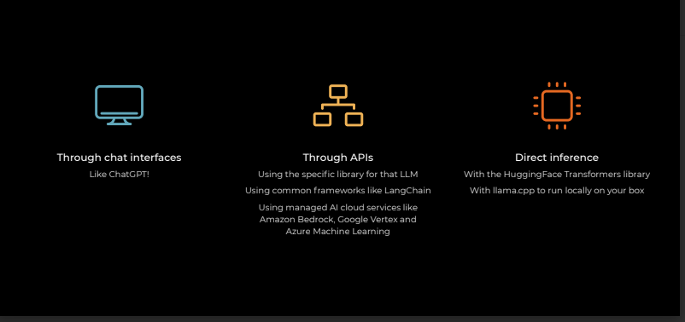
3 ways to use models

Slide 18
Prompt Engineering – Prompt Techniques
🎯 What is Prompting?
Prompting = the way we ask questions to an AI model.
The style of prompt changes the quality of answers.
Different techniques help us get better, clearer, or more logical responses.
🔹 1. Shot Prompting (Zero, One, Few-Shot)
👉 Think of “shots” as examples you give the model before asking your real question.
🟢 Zero-Shot
No example given. Just ask directly.
Examples:
Translate "Hello" to French.
User: Write a polite email apologizing for a delivery delay.
🟡 One-Shot
Give one example.
Examples:
Example: Translate "Hello" → "Bonjour“.
Now translate "Good morning".
2. Example: "Dear Customer, Sorry your order was delayed. We value your patience."
Now: Write an email for a product damaged in delivery.

Slide 19
Prompt Engineering – Prompt Techniques
🔵 Few-Shot
Give a few examples before asking.
Examples:
1. Example: Translate "Hello" → "Bonjour"
Example: Translate "Good night" → "Bonne nuit"
Now translate "Good morning".
2. Example 1: Complaint → Late delivery → Response → Apology for delay
Example 2: Complaint → Wrong item → Response → Apology + replacement
Now: Complaint → Damaged product
🖼️ Real-Time Fit: Training a chatbot to learn tone & style by showing examples.
Zero-shot: [Task] → Answer
One-shot: [Example + Task] → Answer
Few-shot: [Examples + Task] → Answer
2. Multi-Step Prompting
Break a big problem into smaller steps.
Examples:
1. Step 1: List 3 fruits.
Step 2: Translate them into French.
2. Step 1: List the top 3 tourist attractions in Paris.
Step 2: Suggest nearby restaurants for each attraction.
Step 3: Create a 1-day itinerary using them.
🖼️ Real-Time Fit: Breaking complex planning (trip, project) into small manageable steps.
🔹 3. Chain of Thought (CoT)
Ask the model to show its reasoning step by step.
Like asking a student: “Don’t just give me the answer, show me how you solved it.”
Examples:
Q: If you have 2 apples and buy 3 more, how many in total?
A: Step 1: Start with 2 apples.
Step 2: Add 3 more.
Step 3: Total = 5 apples.

Slide 20
Prompt Engineering – Prompt Techniques
🔹 3. Chain of Thought (CoT)
Example:
2. A customer spends $120 monthly on subscriptions.
They cancel 2 subscriptions worth $15 each.
How much do they spend now?
Show your steps.
Answer: Step 1: 2 subscriptions × $15 = $30
Step 2: 120 – 30 = 90
Answer: $90
🖼️ Real-Time Fit: AI explaining loan calculation, billing breakdown, or math in reports.
🔹 4. Tree of Thought (ToT)
Instead of one straight path (like CoT), AI explores different possible paths (like a tree).
Then it picks the best branch.
Examples:
Q: Suggest activities for a rainy day.
AI branches:
Path A: Indoor games → Board games, Puzzles
Path B: Creative → Painting, Writing
Path C: Relax → Reading, Meditation
Final Answer: Combine best options.
2. I want to switch careers. Suggest paths based on my background in software engineering.
AI explores branches:
Path A → Data Science (skills: Python, ML)
Path B → Cloud Architect (skills: AWS, Azure)
Path C → AI Engineer (skills: LLMs, NLP)
Final Answer: “You can choose between Data Science, Cloud, or AI roles. Based on your interest in AI, I recommend AI Engineer.”
🖼️ Real-Time Fit: AI evaluating different career or business strategies, then choosing best.

Slide 21
Prompt Engineering – Prompt Techniques
🔹 5. Self-Consistency
Instead of giving just one answer, the model tries multiple times → then chooses the most consistent/common one.
Question → Multiple Reasonings → Compare → Final Answer
Examples:
Q: What is 25 × 4?
AI may try reasoning 3 times:
Run 1: 100
Run 2: 100
Run 3: 120 (mistake)
Most consistent = 100 ✅
2. A patient has fever, cough, and sore throat.
What are possible causes?
AI generates multiple times:
Run 1 → Flu, Common Cold, COVID-19
Run 2 → Cold, Flu, Allergies
Run 3 → Flu, Cold, COVID-19
Final (most consistent): Flu, Cold, COVID-19.
🖼️ Real-Time Fit: Improves reliability in critical domains (health, finance, law).
🔹 6. Meta-Prompting
Here, the AI is told how to behave while answering (guidelines for thinking).
It’s like giving the AI a “role” or “strategy.”
Meta Instructions → Question → Styled Answer
Examples:
1. You are a teacher.
Always explain answers in simple language.
Now: What is photosynthesis?
2. You are a primary school teacher.
Explain photosynthesis in simple words with a fun example.
🖼️ Real-Time Fit: Controlling tone, role, or style — e.g., teacher, lawyer, marketer.

Slide 22
Prompt Engineering – Prompt Techniques
✅ In short:
Shot prompting → Teach with examples. (chatbot, customer service)
Multi-step → Break big tasks into smaller ones. (trip, projects)
CoT → Step-by-step reasoning. (finance, teaching math)
ToT → Explore multiple reasoning paths. (career, strategy)
Self-consistency → Multiple tries, pick consistent answer. Reliable answers (health, law)
Meta-prompting → Tell the AI how to behave. Role control (teacher, marketer, lawyer).
🖼️ Final Recap with Use Cases
Technique | Real-Time Example
Zero/One/Few-Shot | Customer support chatbot replies
Multi-Step | Travel itinerary planning
Chain of Thought | Banking/finance calculations
Tree of Thought | Career guidance decision-making
Self-Consistency | Healthcare symptom checker
Meta-Prompting | Teacher explaining simply

Slide 23
Context Engineering
🔹 2. Context Engineering
What is it?
Adding relevant background data to the prompt, so the model has more information to work with.
Like giving the model reference notes before asking a question.
Real-Time Examples
Customer Support Bot:
Add your company’s FAQ document as context.
Then ask: “What is the return policy for electronics?”
Model answers using your company policy, not a generic one.
Legal Assistant:
Provide a contract text as context.
Ask: “Summarize key obligations for the vendor.”
Model uses the given contract, not internet knowledge.
✅ Used for:
Question answering (RAG: Retrieval-Augmented Generation)
Chatbots with company data
Domain-specific assistants (healthcare, legal, finance)
Tools Usage (Function Calling, APIs, DB Lookups) is partially related, but not exactly the same as context engineering.
Tools = let the model call external functions (API, database, calculator).
The results from tools can then be added as context for the next step.
User + Extra Context (docs, FAQs, contracts) → Model → Answer with context

Slide 24
Prompt vs Context Engineering
Prompt Engineering = How you ask → improve clarity, format, tone.
Context Engineering = What you provide → add domain knowledge so answers are correct and specific.
In real-world AI:
Prompt Engineering = useful for general tasks (summarization, creative writing).
Context Engineering = required for business/enterprise apps (support bots, legal AI, healthcare assistants).
Prompt vs Context Engineering
Feature | Prompt Engineering ✍️ | Context Engineering 📚
Focus | Better instructions | Add background knowledge
Data Added | No (just wording) | Yes (documents, facts)
Effort | Low (crafting prompts) | Higher (organizing context)
Best For | Improving clarity, formatting | Making answers domain-specific
Example | “Explain AI simply in 3 points” | “Given this FAQ, what is our return policy?”

Slide 25
LLM Models Selection –Various Performance Metrics & Leader Boards
🧠 Why Model Selection Matters?
There are many LLMs (GPT, Claude, LLaMA, Mistral, etc.).
Each model has different strengths (speed, accuracy, reasoning, coding, cost).
Choosing the right model = better results for your use case.
🔹 Part 1: LLM Model Selection Metrics & Criteria
Here are the main metrics beginners should know:
1. Accuracy / Performance
How correct are the answers?
Measured by tasks like Q&A, summarization, coding correctness.
Example: “Did the model solve the math problem correctly?”
2. Reasoning Ability
Can the model explain steps or solve multi-step problems?
Important for math, coding, planning.
3. Knowledge Coverage
How much general/world knowledge it has.
Important for research, tutoring, business insights.
4. Creativity / Generation Quality
Can it write stories, poems, or marketing copy naturally?
Important for content creation.

Slide 26
LLM Models Selection –Various Performance Metrics & Leader Boards
5. Latency (Speed)
How fast does it respond?
Important for real-time apps (chatbots, copilots).
6. Cost / Token Efficiency
Some models are cheaper per token (Mistral, LLaMA).
Important for scaling large apps.
7. Context Window Size
How much input text it can handle at once.
Example:
Small models: 4K tokens (few pages).
Big models: 200K+ tokens (entire books).
Important for document search, legal contracts, RAG.
8. Multimodality
Can it handle text + images + audio?
Example: GPT-4o can process images.
Important for vision-based apps, assistants.
9. Safety & Reliability
Does it avoid hallucinations or harmful content?
Important for healthcare, education, finance.

Slide 27
LLM Models Selection –Various Performance Metrics & Leader Boards
🔹 Part 2: Popular LLM Leaderboards
Leaderboards are like report cards for LLMs. They test many models on the same tasks → so we can compare them.
✅ Popular LLM Leaderboards
1. Hugging Face Open LLM Leaderboard
Compares open-source models.
Metrics: reasoning, MMLU (knowledge), coding, commonsense.
Great for picking open models like LLaMA, Mistral, Falcon.
Link: https://huggingface.co/spaces?search=leaderboard
2. Chatbot Arena (by LMSYS)
Human-vs-human voting (blind A/B tests).
Real users compare answers side by side.
Great for choosing best overall chat experience.
Link: https://lmarena.ai/
3. HELM (Holistic Evaluation of Language Models)
By Stanford.
Tests models across many scenarios: bias, fairness, accuracy, robustness.
Great for research and responsible AI.
Link: https://crfm.stanford.edu/helm/
4. MT-Bench (Multi-Turn Benchmark)
Evaluates how good models are at multi-turn conversations.
Great for chatbot and assistant design.
Link: https://www.deepchecks.com/llm-evaluation/
5. .Vellum.ai : https://www.vellum.ai/llm-leaderboard?utm_source=direct&utm_medium=none
6. Scale.com: https://scale.com/leaderboard

Slide 28
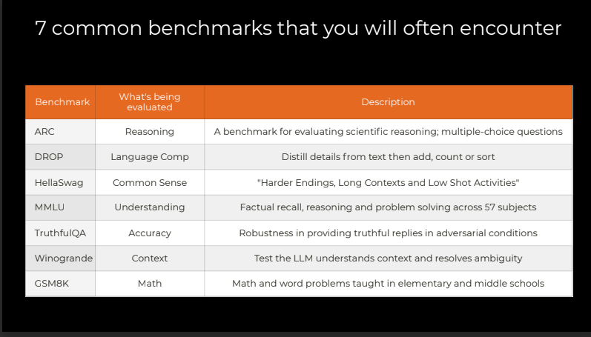
LLM Models Selection – Common Benchmarks
7 common benchmarks that you will often encounter

Slide 29
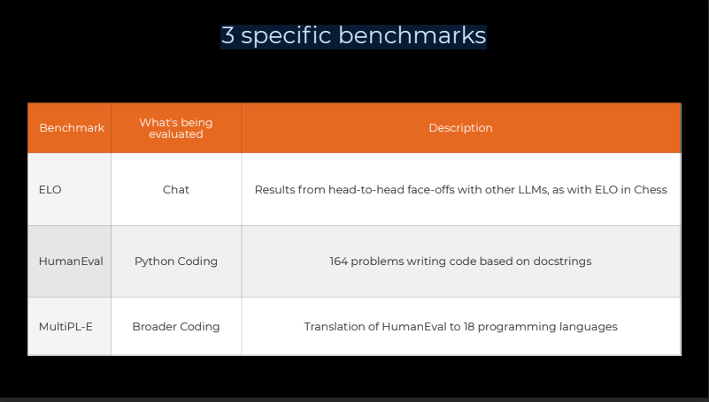
LLM Models Selection – Common Benchmarks
3 specific benchmarks

Slide 30
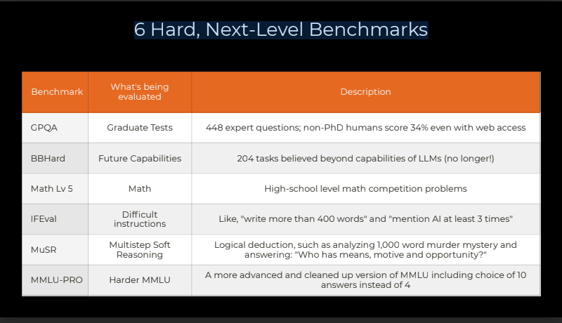
LLM Models Selection – Common Benchmarks
6 Hard, Next-Level Benchmarks

Slide 31
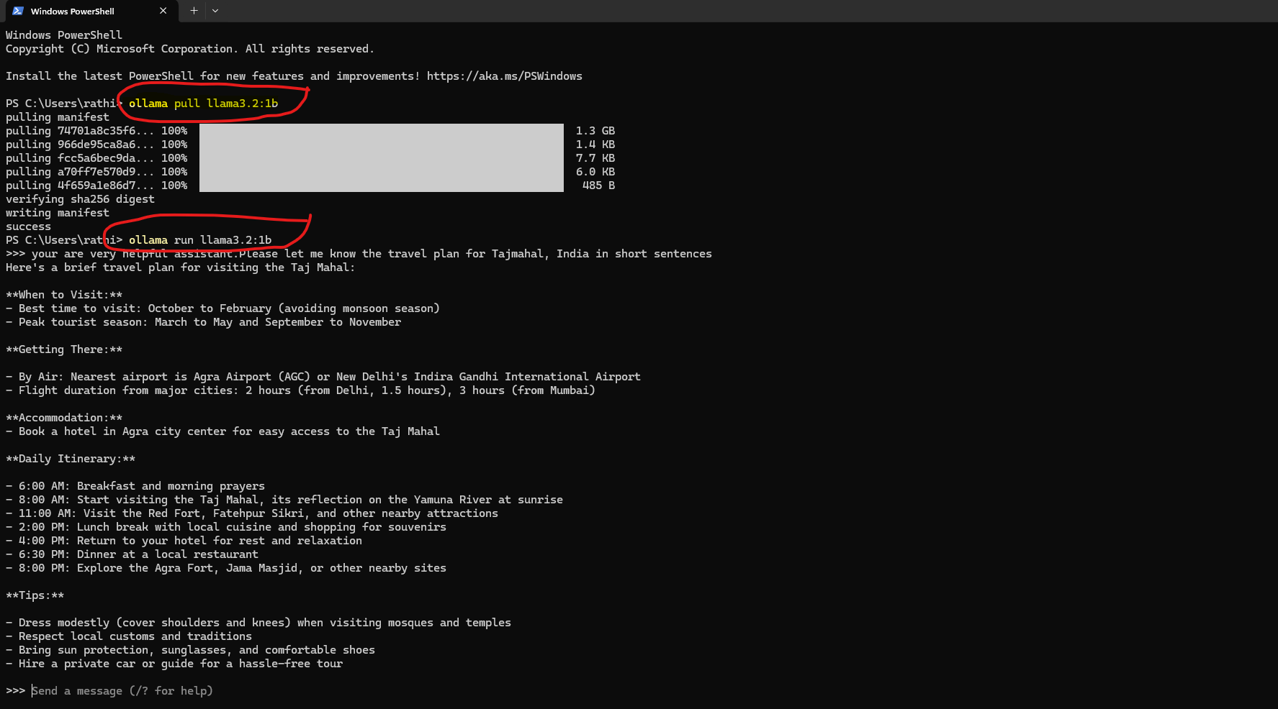
LLM Calling- CLI Command
CLI Command
Simply visit [ollama.com](https://ollama.com) and install! Once complete, the ollama server should already be running locally.
If you visit: [http://localhost:11434/](http://localhost:11434/)
You should see the message `Ollama is running`.
If not, bring up a new Terminal (Mac) or Powershell (Windows) and enter `ollama serve` and in another Terminal (Mac) or Powershell (Windows), enter `ollama pull llama3.2` , then try [http://localhost:11434/](http://localhost:11434/) again.
If Ollama is slow on your machine, try using `llama3.2:1b` as an alternative. Run `ollama pull llama3.2:1b` from a Terminal or Powershell, and change the code below from `MODEL = "llama3.2"` to `MODEL = "llama3.2:1b"`

Slide 32
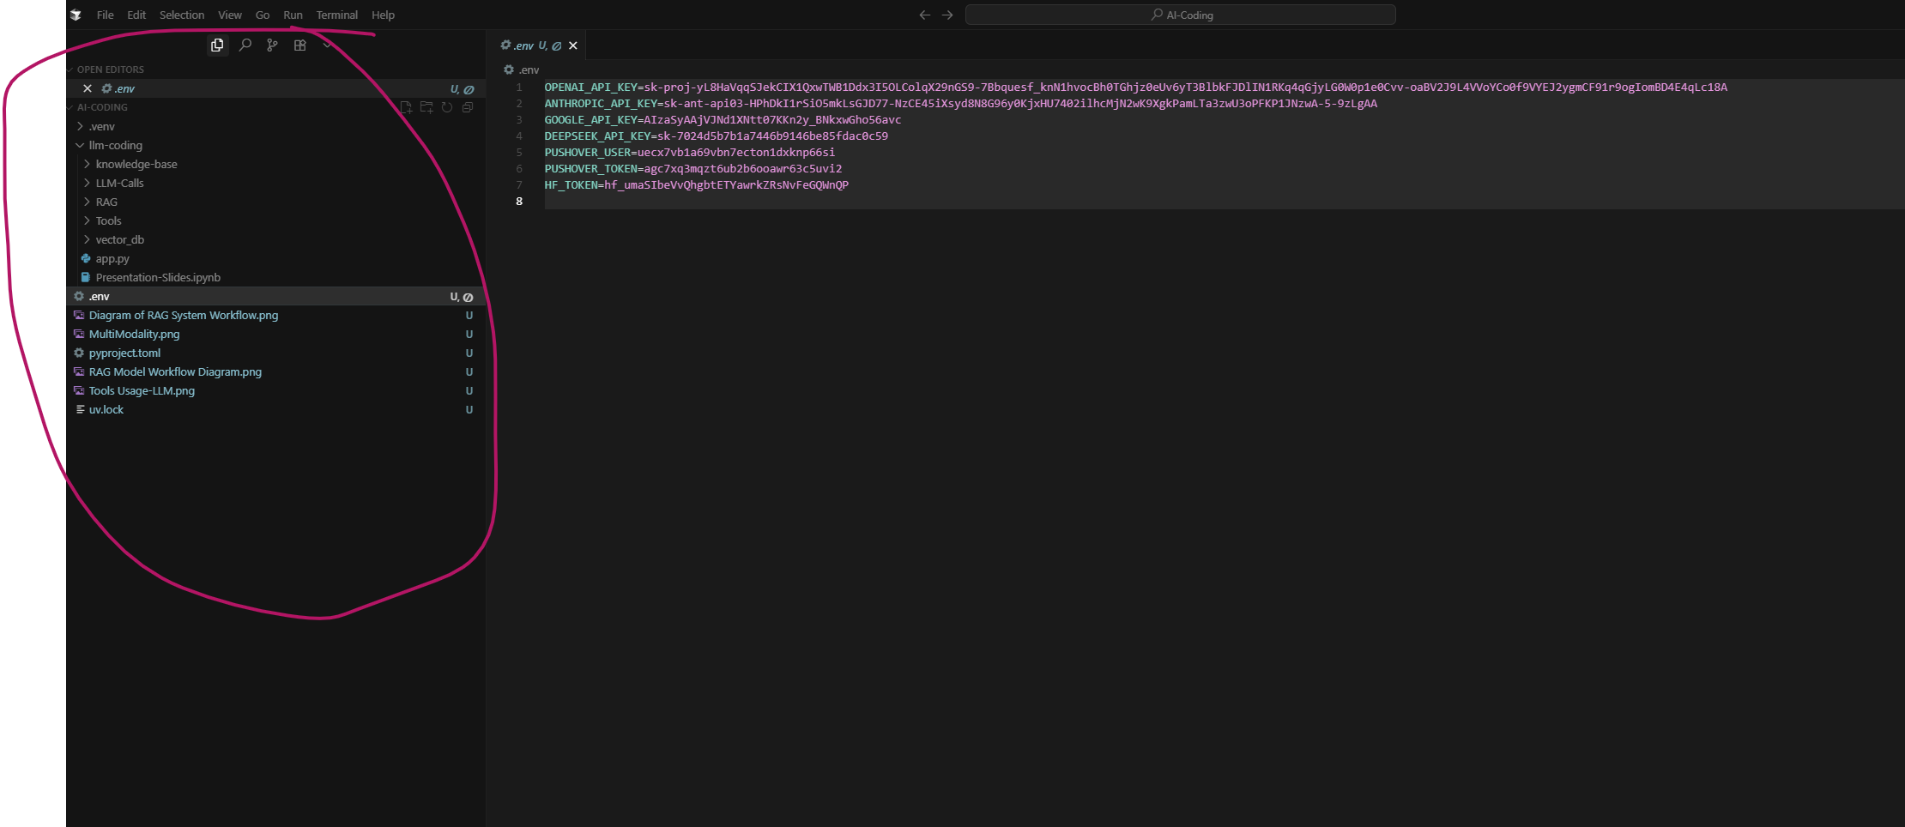
LLM Coding – Python Environment Setup
Please follow the below steps to set up your Python environment for LLM Coding and refer to cusrsor IDE , UV installation , API key setup in the next slides.
1. Clone the github repo into your local project folder by running this clone command “git clone https://github.com/rathina4aicoding/AI-Coding.git” (This is the project folder that will be opened up in your cursor IDE as cursor Project folder)
2. Cursor setup – Free download from https://www.cursor.com/ , install it and complete the setup.
3. Set up your project folders in your local ; For Eg. C:\Users\rathi\Projects\AI-Coding\llm-coding\
4. Open the local project folder (C:\Users\rathi\Projects\AI-Coding\llm-coding\) from your Cursor IDE
5. Add the pyproject.toml & uv.lock files into your project folder in Cursor. (Rathina will share these 2 files)
6. Download UV Package Manager from https://docs.astral.sh/uv/getting-started/installation/#__tabbed_1_1 and install it in your machine (windows/mac)
7. Run the command “uv sync” in the terminal to install all the libraries and dependencies from pyproject.toml & uv.lock files.
8. Create a .env file in the same project folder in cursor to add your API keys from respective model providers such as OpenAI, Anthropic, Google, Deepseek etc
9. Create an account for each LLM Model provider tech company , create API keys and add then into .env file as shown below
OPENAI_API_KEY=xxxx
ANTHROPIC_API_KEY=xxxx
GOOGLE_API_KEY=xxxx
DEEPSEEK_API_KEY=xxxx
You are all set to go for LLM Coding!!!
The final cursor should look like below

Slide 33
Cursor IDE – Setup
🧑‍💻 What are these tools?
Cursor IDE → A full coding editor built around AI (like VS Code, but AI-first).
Claude Code → An AI coding assistant (part of Anthropic’s Claude models) that helps generate or improve code inside an IDE or chat.
🔄 Cursor IDE vs Claude Code (Side-by-Side)
Install Cursor
Visit cursor at https://www.cursor.com/
Click Sign In on the top right, then Sign Up, to create your account
Download and follow its instructions to install and open Cursor
Feature | Cursor IDE 🖥️ | Claude Code 🤖
What it is | Full IDE with AI built in | AI coding assistant
Best for | End-to-end coding (write, test, debug) | Explaining & generating code
Strength | Project-level context, inline fixes | Clear reasoning, safe suggestions
Model support | Multi-model (Claude, GPT, etc.) | Claude models only
Where used | Replace VS Code fully | Plug into any IDE or chat
Beginner value | Learn by experimenting with AI in a full coding environment | Learn by asking “why” & getting human-like code explanations

Slide 34
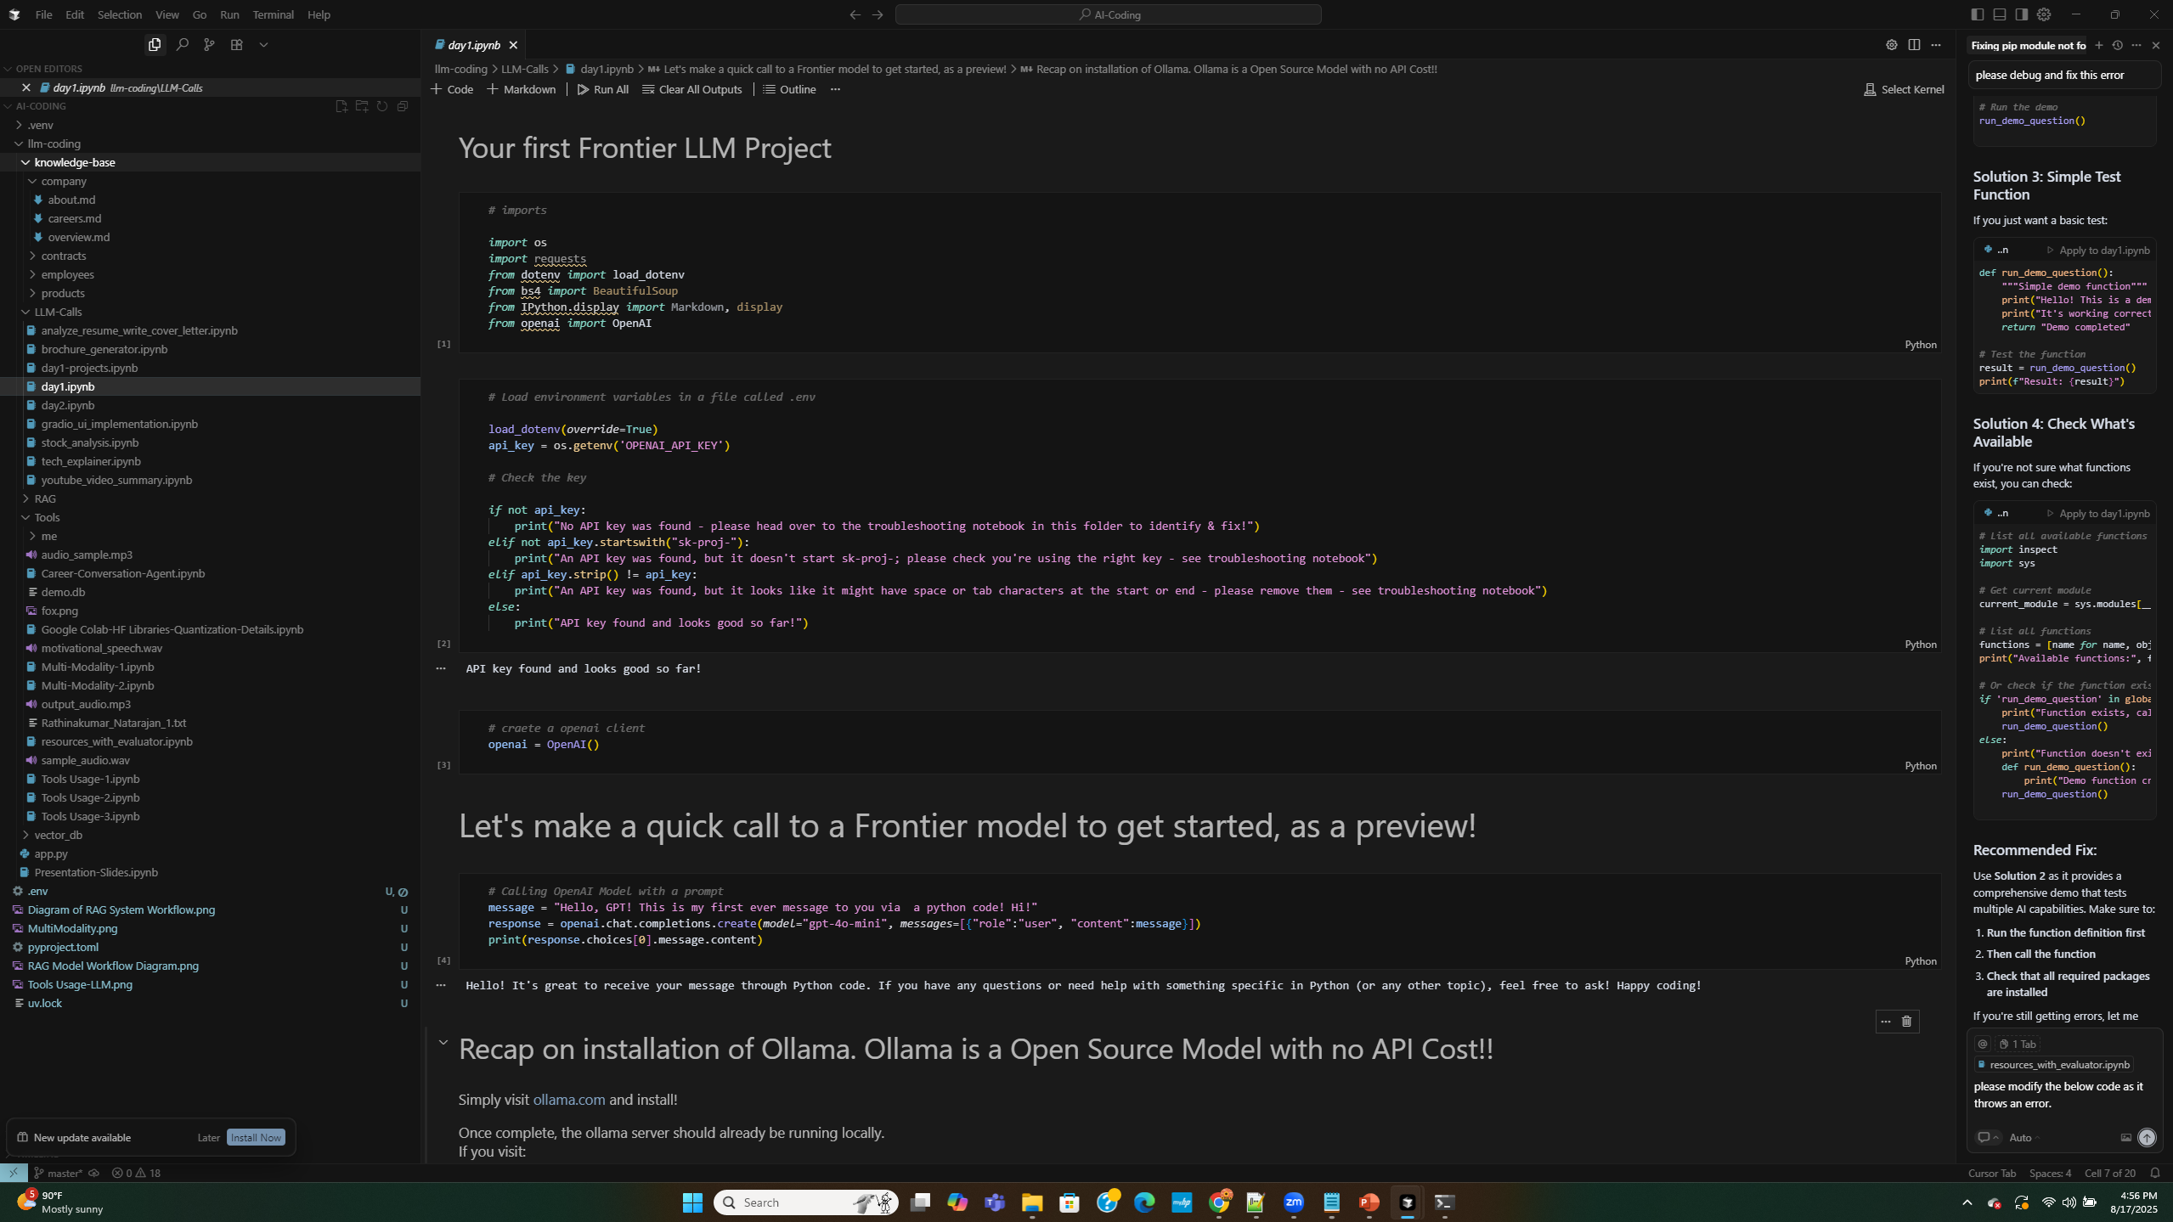
Cursor IDE – Setup

Slide 35
UV Python Package Manager – Setup
The Amazing UV
Follow the instructions here to install uv - I recommend using the Standalone Installer approach at the very top:
https://docs.astral.sh/uv/getting-started/installation/
Then within Cursor, select View >> Terminal, to see a Terminal window within Cursor.
Type “pwd” to see the current directory, and navigate to your project directory – For Eg C:\Users\rathi\Projects\AI-Coding\llm-coding\
Run below command to install UV for Windows
>> powershell -ExecutionPolicy ByPass -c "irm https://astral.sh/uv/install.ps1 | iex“
For Mac or Linux
>> curl -LsSf https://astral.sh/uv/install.sh | sh
If your system doesn't have curl, you can use wget:
>> wget -qO- https://astral.sh/uv/install.sh | sh
Request a specific version by including it in the URL:
>> curl -LsSf https://astral.sh/uv/0.8.12/install.sh | sh
Start by running uv self update to make sure you're on the latest version of uv.
Note: One thing to watch for: if you've used Anaconda before, make sure that your Anaconda environment is deactivated
>> conda deactivate
And if you still have any problems with conda and python versions, it's possible that you will need to run this too:
>> conda config --set auto_activate_base false
And now simply run:
>> uv sync
And marvel at the speed and reliability! If necessary, uv should install python 3.12, and then it should install all the packages.
If you get an error about "invalid certificate" while running uv sync, then please try this instead:
>> uv --native-tls sync
And also try this instead:
>> uv --allow-insecure-host github.com sync

Slide 36
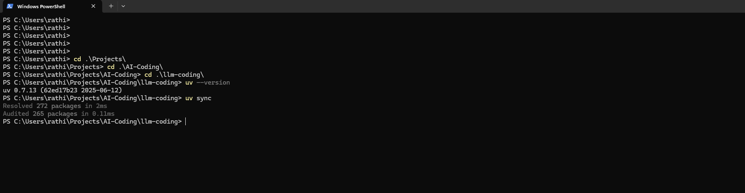
UV Python Package Manager – Setup

Slide 37
LLM Calling- API Key Setup
API Key Setup
For OpenAI, visit https://openai.com/api/
For Anthropic, visit https://console.anthropic.com/
For Google, visit https://ai.google.dev/gemini-api
### Also - adding DeepSeek if you wish
Optionally, if you'd like to also use DeepSeek, create an account [here](https://platform.deepseek.com/), create a key [here](https://platform.deepseek.com/api_keys) and top up with at least the minimum $2 [here] (https://platform.deepseek.com/top_up).
### Adding API keys to your .env file
When you get your API keys, you need to set them as environment variables by adding them to your `.env` file.
```
OPENAI_API_KEY=xxxx
ANTHROPIC_API_KEY=xxxx
GOOGLE_API_KEY=xxxx
DEEPSEEK_API_KEY=xxxx
```
Afterwards, you may need to restart the Jupyter Lab Kernel (the Python process that sits behind this notebook) via the Kernel menu, and then rerun the cells from the top.

Slide 38
LLM Model – Inferencing vs Fine Tuning
🧠 First: What are these terms?
Inferencing = Using the model to get answers.
Fine-Tuning = Training the model further on your own data to specialize it.
Think of it like:
Inferencing → Asking a teacher a question.
Fine-Tuning → Giving the teacher extra lessons so they become an expert in your subject.
🔹 1. Inferencing (Using the Model)
You use a pre-trained model (like GPT, Claude, LLaMA) to generate answers.
You don’t change the model; you just send input and get output.
✅ Real-time Use Cases
Chatbots answering FAQs
Translating text
Writing product descriptions
Generating code snippets
User Input → Pretrained Model → Output
🔹 2. Fine-Tuning (Custom Training)
You take a base LLM and train it with your data.
The model “learns” your style, domain, or company knowledge.
Example:
Base model knows general English.
You fine-tune it with medical documents → now it becomes better at medical Q&A.

Slide 39
LLM Model – Inferencing vs Fine Tuning
2. Fine-Tuning (Custom Training)
✅ Real-time Use Cases
Healthcare bot trained on medical guidelines
Banking assistant trained on financial regulations
Retail bot trained on product catalog and company policies
Legal assistant fine-tuned with case law
Base Model + Custom Data → Fine-Tuned Model → Domain-Specific Output
Inferencing vs Fine Tuning
✅ In Summary
Inferencing = Directly use the model to answer (no extra training).
Fine-Tuning = Customize the model with your data for better domain-specific performance.
Beginners should start with inferencing. Fine-tuning is useful only when general models don’t perform well for your specialized needs.
Feature | Inferencing (Using) | Fine-Tuning (Customizing)
What it does | Uses existing model | Retrains with your data
Effort needed | Low (just prompt) | Higher (need data + training)
Speed | Ready to use instantly | Takes time to train
Cost | Pay per usage | Training cost + usage cost
Best for | General tasks | Domain-specific tasks
Example | Translate text | Medical chatbot

Slide 40
Model Parameters – Temperature, Top P, Top K
🧠 First: Why Do We Need These?
When an LLM generates text, there are usually many possible next words.
Example: “The cat is …” → could be sleeping, running, cute, hungry…
Temperature, Top-P, and Top-K are settings that control randomness vs determinism in choosing those words.
👉 Think of them as knobs you turn to control how “creative” or “predictable” the model’s answers are.
🔹 1. Temperature
Controls randomness (how adventurous the model is).
Range: usually 0.0 → 1.0+
Low (0.1) → Safe, predictable answers.
High (1.0) → More random, creative answers.
✅ Real-Time Use Cases:
Low temp (0.1–0.3): Legal, medical, or coding tasks → Need accuracy & consistency.
High temp (0.8–1.0): Story writing, brainstorming, poetry → Need creativity.
Example:
Prompt: "Suggest a name for a coffee shop."
Temp 0.2 → "Central Coffee"
Temp 1.0 → "Brew Galaxy" / "Moonlit Beans" / "Buzz Haven"

Slide 41
Model Parameters – Temperature, Top P, Top K
🔹 2. Top-K
Limits how many top choices the model considers.
Example: If K=5 → only the top 5 most likely next words are considered.
✅ Real-Time Use Cases:
Low K (small set, e.g., K=3): Safer, focused outputs → good for Q&A, factual answers.
High K (larger set, e.g., K=50): More variety → good for creative writing or marketing.
Example:
Prompt: "The cat is..."
Top-K = 3 → ["sleeping", "running", "sitting"]
Top-K = 50 → ["sleeping", "dancing", "plotting", "hungry", "singing", ...]
🔹 3. Top-P (Nucleus Sampling)
Looks at cumulative probability until it covers P (like 90%).
Instead of a fixed number of words (like Top-K), it adapts dynamically.
Example: Top-P = 0.9 → model chooses from the smallest set of words that together make up 90% probability.
✅ Real-Time Use Cases:
Low P (0.3–0.5): More focused → technical or critical domains.
High P (0.8–0.95): More variety → creative, casual conversations.
Example:
Prompt: "The weather today is..."
Top-P = 0.4 → ["sunny", "rainy"]
Top-P = 0.9 → ["sunny", "rainy", "windy", "stormy", "humid", ...]

Slide 42
OpenAI-GPT Models Comparisons
Model | Context Window Size | Knowledge Cutoff | Approx. Parameter Size | Expertise / Strengths | Uses & Benefits
GPT‑4o‑mini | ~128K tokens | October | Not publicly disclosed | Fast, cost-efficient multimodal (text + image) processing | Great for long-context handling with mixed media at lower cost
GPT-4.1-mini | ~1M tokens | ~June 2024 | Not publicly disclosed | Strong in coding, instruction following, vision tasks | Efficient for interactive agents, image reasoning, mid-tier tasks with long context
GPT-4.1-nano | ~1M tokens | ~June 2024 | Not publicly disclosed | Fastest and cheapest; lightweight reasoning | Suits autocomplete, quick processing, large document parsing at minimal cost
GPT-4.1 (std) | ~1M tokens | ~June 2024 | Not publicly disclosed | Best performance on coding, long-context reasoning | Ideal for complex reasoning, large codebases, advanced AI agents
o4-mini | ~100K tokens (approx.) | Not explicitly stated (2025 timeframe) | Not publicly disclosed | Reasoning-focused; supports multimodal reasoning with chain-of-thought and images | Great for visual reasoning, technical or domain-specific multimodal tasks
GPT-5 | Input + output up to total 400K tokens (272K input + 128K output) Some sources mention 256K tokens context—likely related to interface limits | Main: ~October 1 2024; mini/nano: ~May 31 2024 or dynamic, updated via retrieval (no fixed date) | Not publicly disclosed multiple tiers; dynamic routing system | PhD-level coding, advanced reasoning, multimodal, agentic tasks, lower hallucinations, safe completions | Best for high-complexity tasks (software dev, health, planning), voice/chat integrations, personalization, enterprise AI, long retrieval tasks

Slide 43
Anthropic, Google & DeepSeek Models Comparisons
Model Family | Model / Variant | Context Window Size | Total Parameters | Knowledge Cutoff | Expertise / Strengths | Uses & Benefits
Anthropic Claude | Claude 3 Opus/Sonnet/Haiku | ~200k tokens (1M tokens for enterprise) | Not publicly disclosed | August 2023 (Claude 3) March 2025 (Claude 4) | Fast (Haiku), balanced reasoning (Sonnet), powerful coding & logic (Opus) | Long-document summarization, coding, high-context legal/business analysis
 | Claude 4 Sonnet / Opus | 200 k tokens base; now up to 1 M tokens for enterprise | Not disclosed | March 2025 (release) | Hybrid reasoning with long-horizon task capability | Extended coding workflows, agentic tasks, research/human-in-the-loop workloads
Google Gemini | Gemini 1.5 Pro / Flash | Up to 1 M tokens (even 10 M tested) | Not officially disclosed; 1.5 Pro estimated >200B | January 2025 ( | Multimodal, fast, structured outputs, tool integration, reasoning-rich | Large-scale processing, agentic applications, coding, multimodal interactions
 | Gemini 2.5 Pro / Flash / Flash-Lite / Live | Up to 1 M tokens input; Flash output 65k tokens; Live output 8k tokens | Not disclosed | January 2025 | Enhanced reasoning (“thinking”), tool usage, real-time (Live) capabilities | High-throughput agentic tasks; real-time voice/video interactions; coding
DeepSeek | DeepSeek-LLM (67B / 7B) | ~4K tokens context | 7B or 67B parameters | Not specified | Strong general capabilities vs open models, code & math focus | Open research, cost-competitive coding/math workflows
 | DeepSeek-Coder (1.3B–33B) | 16 K tokens | 1.3B to 33B (various sizes) | Not specified | Specialized for code intelligence, instruction following. | Software development tools, code completion, programming tasks
 | DeepSeek-V2 | 128 K tokens | 236B total; 21B activated per token | Not specified | MoE architecture, efficient long-context inference, strong performance | Long-context tasks, efficient reasoning, strong open-performance
 | DeepSeek-V3 | Not specified (business chatbot accepts long input) | 671B total; 37B activated per token | Not specified | Top-tier open-source performance, MoE + efficient inference. | Research, cost-effective deployment, high-value generative and reasoning tasks
 | DeepSeek-R1 | Not specified | Distilled ranges: 1.5B to 70B (plus full model) | Not specified | Reinforcement-learning-enhanced reasoning, chain-of-thought, open source | Reasoning tasks, healthcare diagnostics, educational and mathematical domains

Slide 44
Perplexity, Mistral & Grok Models Comparisons
Model Family | Model / Variant | Context Window Size | Total Parameters (approx.) | Knowledge Cutoff | Expertise / Strengths | Uses & Benefits
Perplexity | pplx-7b-online | 8K – 32K tokens | ~7B | 2023 (dynamic web retrieval adds freshness) | Lightweight, fast inference, retrieval-augmented search | Real-time question answering, search + LLM hybrid usage
 | pplx-70b-online | 32K tokens | ~70B | 2023 (dynamic with web) | Strong reasoning, larger scale retrieval + generation | Knowledge assistant, enterprise search, contextual Q&A
 | pplx-large (based on LLaMA/GPT mix) | 32K–128K tokens | ~13B–70B (varies by backend) | 2023–2024 | Optimized for browsing + synthesis | AI search engine experience, live document summarization
Mistral | Mistral 7B | 8K tokens | 7B | 2023 | General-purpose, efficient, open-source | Text generation, summarization, cost-efficient deployments
 | Mixtral 8x7B (MoE) | 32K tokens | 46.7B total (12.9B active) | 2023 | Mixture-of-Experts, efficient compute with strong reasoning | High-performance inference at lower cost, coding, chatbots
 | Mistral Large (22B) | 32K tokens | ~22B | 2024 | Advanced reasoning, better multilingual support | Knowledge tasks, enterprise workflows, high-context reasoning
 | Mixtral 8x22B | 64K tokens | 176B total (39B active) | 2024 | Large MoE, strong in coding/math + reasoning | Long-context analysis, code intelligence, competitive with frontier models
Grok (xAI) | Grok-1 | 8K tokens | ~33B | Q3 2023 | Humor-infused responses, strong math & code | Creative Q&A, coding assistant, social media (X) integration
 | Grok-1.5 | 128K tokens | ~33B+ (optimized) | Q1 2024 | Long-context reasoning, improved logic | Document analysis, advanced conversations, integration in X platform
 | Grok-2 | 128K–200K tokens | Not disclosed (likely >70B) | Late 2024 | Multimodal reasoning (text + images), strong agent features | Visual + text reasoning, real-time assistants, competitive with GPT-4.1/Gemini
 | Grok-3 (expected 2025) | 1M tokens (planned) | Not disclosed | 2025 | Frontier-level reasoning and creativity | Enterprise AI, AGI research, advanced multimodal assistants

Slide 45
Open Source Models Comparisons
Model Family | Model / Variant | Context Window Size | Total Parameters (approx.) | Knowledge Cutoff | Expertise / Strengths | Uses & Benefits
Meta LLaMA | LLaMA-2 (7B / 13B / 70B) | 4K – 32K tokens | 7B, 13B, 70B | 2023 | General reasoning, coding, multilingual | Text generation, research, lightweight coding assistant
 | LLaMA-3 (8B / 70B) | 8K – 128K tokens | 8B, 70B | 2023 | Improved multilingual, safety, reasoning | Chatbots, enterprise apps, long-context document tasks
Mistral | Mistral 7B | 8K tokens | 7B | 2023 | Small but efficient, strong reasoning | Cost-efficient chatbots, summarization, text classification
 | Mixtral 8x7B (MoE) | 32K tokens | 46.7B total (12.9B active) | 2023 | Sparse MoE, efficient compute, better coding/math | Coding assistants, reasoning tasks, cost-optimized large-scale inference
 | Mistral Large (22B) | 32K tokens | ~22B | 2024 | Advanced reasoning, multilingual, knowledge-rich | Enterprise workflows, legal/financial analysis, coding
DeepSeek | DeepSeek-LLM (7B/67B) | 4K – 16K tokens | 7B, 67B | 2023 | Strong open performance, cost-efficient | General text generation, math, coding
 | DeepSeek-Coder (1.3B–33B) | 16K tokens | 1.3B – 33B | 2023 | Code-specialized, instruction tuned | Software development, code completion, debugging
 | DeepSeek-V2 | 128K tokens | 236B total (21B active) | 2024 | MoE design, efficient long-context inference | Long-document reasoning, retrieval-augmented workflows
 | DeepSeek-V3 | Not specified | 671B total (37B active) | 2024 | Cutting-edge MoE, state-of-art open source | Enterprise AI, advanced research, high-efficiency deployments
Falcon | Falcon-7B / 40B | 4K – 8K tokens | 7B, 40B | 2023 | Strong open-source pretraining, multilingual | Academic research, enterprise NLP, knowledge tasks
MPT (MosaicML) | MPT-7B / 30B | 8K – 32K tokens | 7B, 30B | 2023 | Open training data transparency, customization | Fine-tuning, domain-specific applications, summarization
Cohere | Command R+ | 128K tokens | Not disclosed (~30B est.) | 2024 | Retrieval-augmented generation, dialogue tuned | Enterprise RAG, chatbots, knowledge assistants
OpenHermes | OpenHermes 13B / 70B | 8K – 16K tokens | 13B, 70B | 2023–2024 | Chat and instruction tuned, community-driven | Conversational AI, open research, fine-tuning
Phi (Microsoft) | Phi-2 (2.7B), Phi-3 (3.8B / 14B / 38B) | 4K – 128K tokens | 2.7B, 3.8B, 14B, 38B | 2023–2024 | Efficient small models with strong reasoning | On-device LLMs, edge AI, cost-sensitive deployments
Gemma (Google) | Gemma 2B / 7B | 8K – 16K tokens | 2B, 7B | 2024 | Lightweight, tuned for ethical/safe outputs | Research, prototyping, fine-tuning, smaller-scale apps
OLMo (AI2) | OLMo 7B / 13B | 8K tokens | 7B, 13B | 2023 | Fully open weights + training data transparency | Academic research, reproducible benchmarks, open experimentation

Slide 46
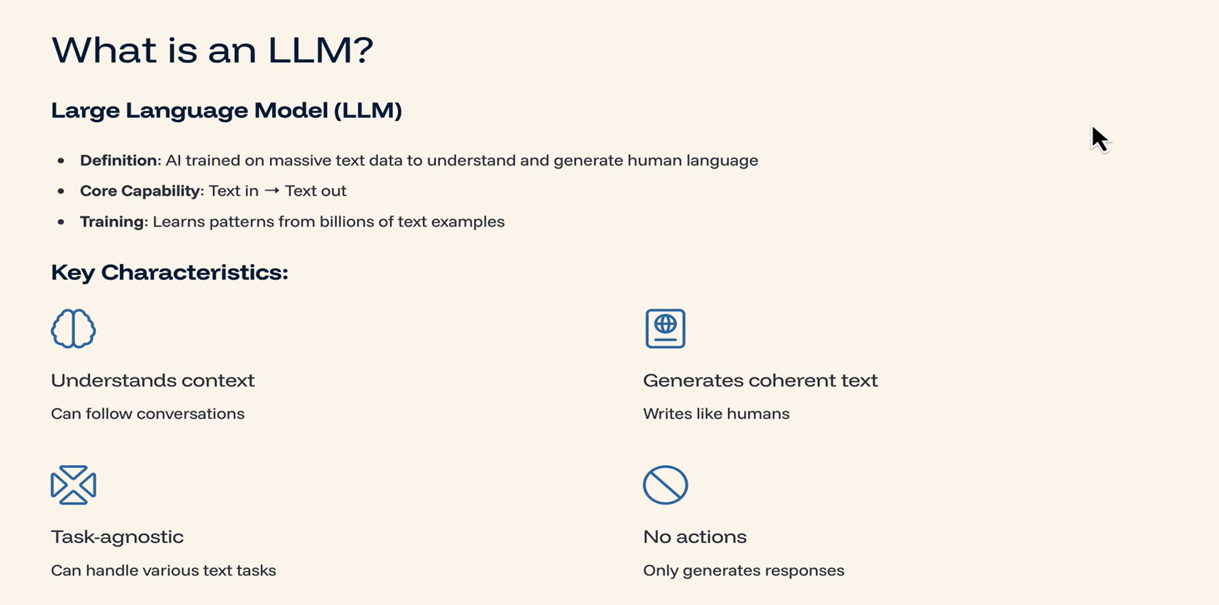
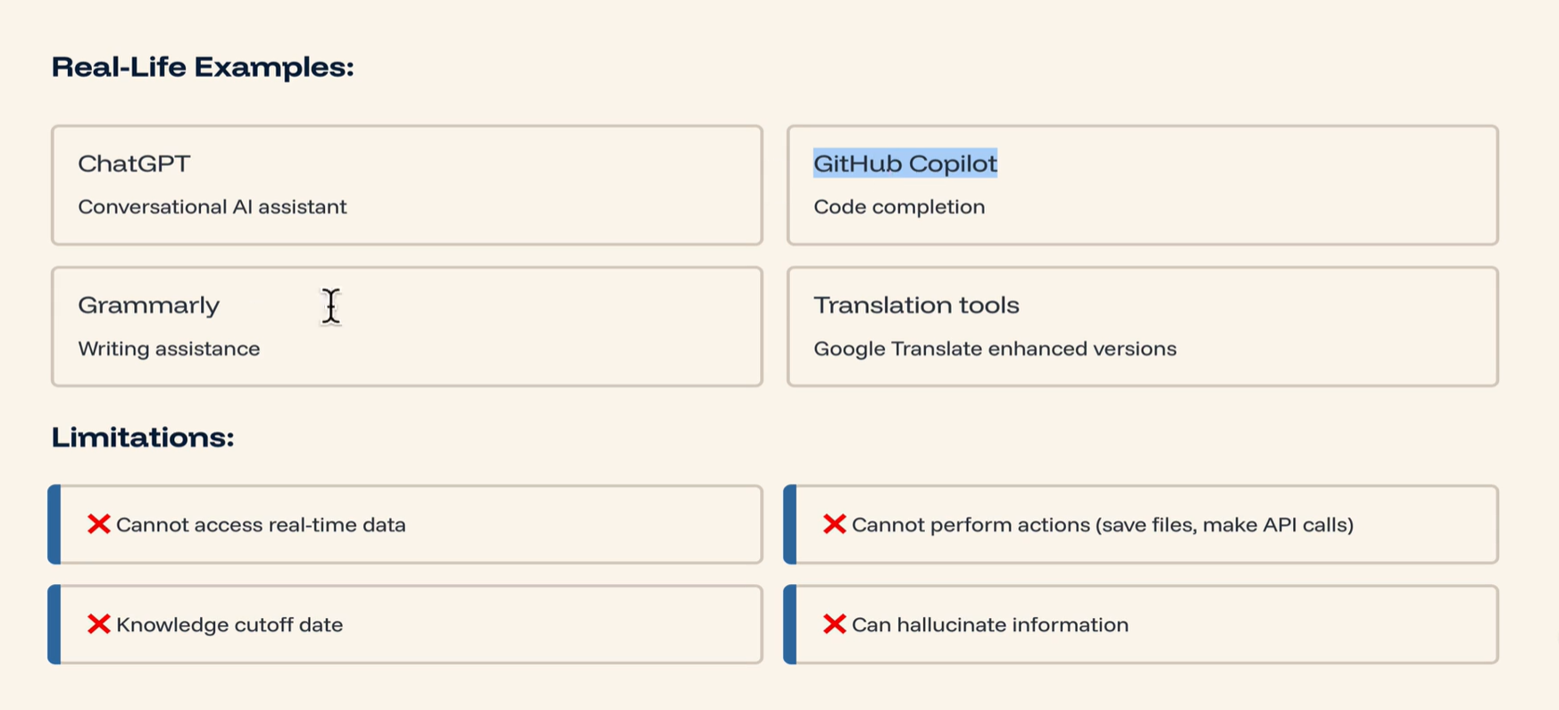
LLM vs AI Agent

Slide 47
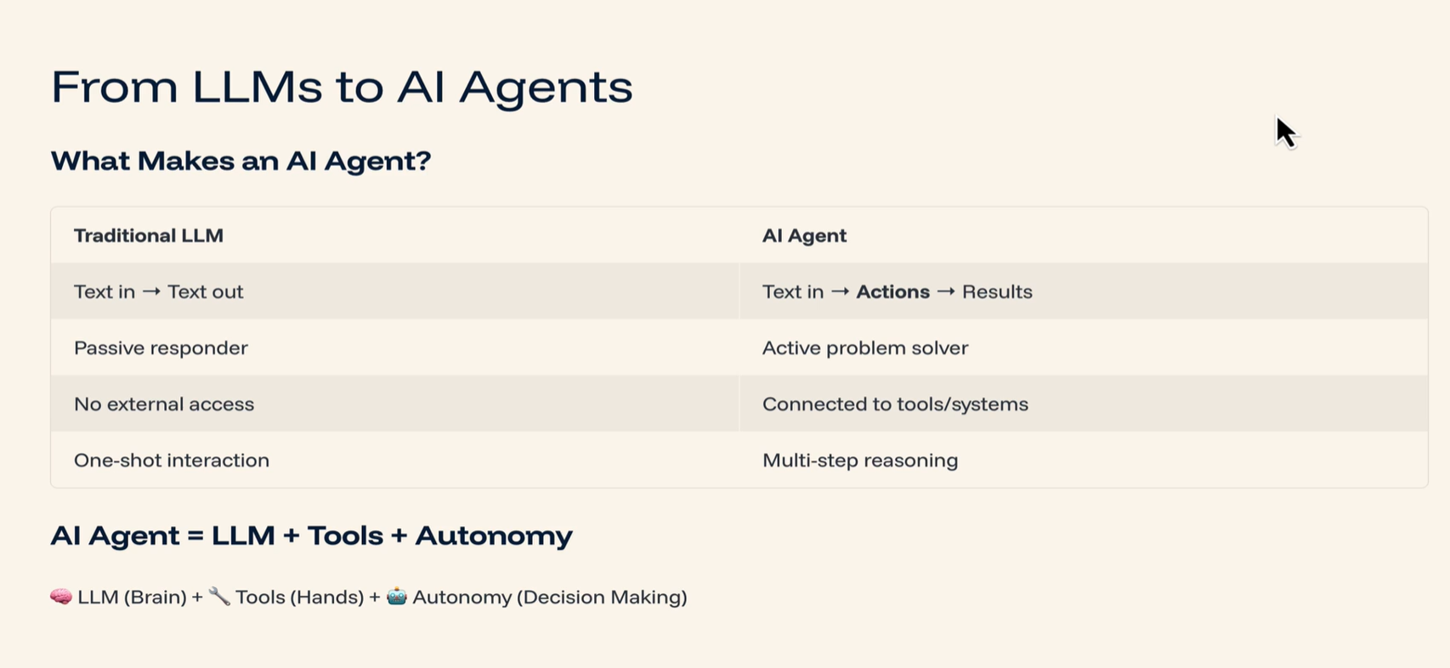
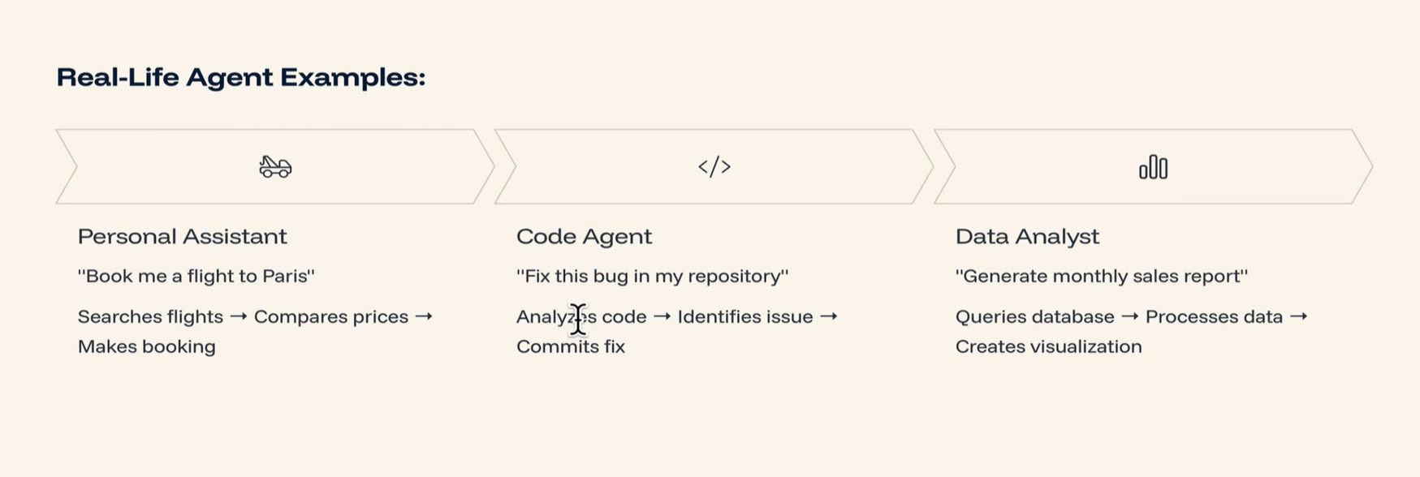
LLM vs AI Agent

Slide 48
Multimodality in LLM Engineering
What is Multimodality in LLM Engineering?
Multimodality refers to an AI model's ability to understand and process multiple types of input data (modalities)—such as:
Text
Image
Audio
Video
Sensor/Tabular data
Instead of working with just one type of input (e.g., text in traditional LLMs like GPT-3), multimodal models like GPT-4o, Gemini, Claude, or Kosmos can see, hear, read, and even respond across formats—just like humans.
Real-Time Industrial Use Cases:
1. Banking & Finance - AI-driven Fraud Detection - Inputs: Transaction logs (tabular), customer call audio (audio), chat transcripts (text)
2. Healthcare - Clinical Report Generation - Inputs: X-ray or MRI images (image) + doctor’s notes (text)
3. Retail & E-Commerce - Smart Product Recommendations - Inputs: Product image (image), customer reviews (text), voice queries (audio)
4. Insurance - Automated Claim Processing - Inputs: Accident images (image), voice explanation (audio), claim forms (text)
5. Customer Support - Virtual Multimodal Assistant - Inputs: User chat (text), screenshot/image (image), screen recording (video)

Slide 49
Tool Usage in LLMs
# What is Tool Usage in LLMs?
In LLM Engineering, "Tool usage" refers to the ability of a Language Model to call external tools or functions to accomplish tasks it can't solve with language generation alone.
It’s like giving the LLM a calculator, web browser, code interpreter, or database it can use when it needs help beyond just "talking".
🧰 Why Do LLMs Need Tools?
Even the smartest LLMs have limitations:
❌ They can't do real-time lookups
❌ They don't access external databases
❌ They can’t always perform accurate math
❌ They may hallucinate when asked about current data
So, we empower them with tools like:
🧮 Code interpreters (Python/Math tools)
🔎 Web search APIs
📊 Database connectors
📦 Internal company APIs
📅 Calendar / Email integrations
🏭 Real-Time Use Cases by Industry
Banking & Financial Services
Use Case: Real-time credit score checker
🔧 Tool: Internal API to fetch credit history
🤖 LLM: Takes user details → Calls tool → Returns score and offers
2. Healthcare
Use Case: Patient symptom analyzer
🔧 Tool: Symptom checker API + patient records
🤖 LLM: Combines symptoms + tool output → Suggests probable conditions
3. E-Commerce
Use Case: Order tracking assistant
🔧 Tool: Delivery tracking API
🤖 LLM: Takes order ID → Calls tool → Gives delivery status + ETA
4. IT Helpdesk
Use Case: Ticket auto-triaging
🔧 Tool: ServiceNow or Jira API
🤖 LLM: Understands request → Classifies → Creates or routes ticket
5. Customer Support
Use Case: Dynamic FAQ Bot with live answers
🔧 Tool: Knowledge base + web search
🤖 LLM: Searches most up-to-date article → Gives accurate response

Slide 50
RAG (Retrieval-Augmented Generation)
# What is RAG (Retrieval-Augmented Generation)?
### Simple Definition:
RAG is a technique where a Language Model (like ChatGPT) retrieves relevant information from external sources before generating an answer.
It combines:
🔍 Retrieval: Fetch facts from a knowledge base or documents
📝 Generation: Use the LLM to create a natural-language response based on the retrieved content
### 🔧 Why Use RAG?
LLMs have a knowledge cutoff and can't remember specific enterprise data or real-time updates. RAG fixes this by:
Giving LLMs access to external information (e.g., PDFs, websites, databases)
Making them factual and grounded
Preventing hallucination (LLMs making up stuff)
🧪 RAG = Retrieval + Generation
Think of it like an open-book exam.
The LLM has access to the "book" (retrieval), so its answer is more factual and less guesswork.
### 🧬 RAG Architecture (Simplified)
User Question
│
[Retriever] ──► Searches in a vector store (e.g., FAISS, Pinecone)
│
Relevant Documents
│
[LLM Generator] ──► Combines context + question
│
Final Answer

Slide 51
RAG (Retrieval-Augmented Generation)
### 🏭 Real-Time Use Cases by Industry
1. Banking & Finance
Use Case: Financial Assistant Bot -> 📥 User asks about tax implications on a new investment -> 🔍 Retriever fetches latest tax rule document -> 🤖 LLM explains the clause in natural
language
2. Healthcare
Use Case: Medical Reference Support -> 📥 Doctor queries about drug interactions -> 🔍 Retriever pulls from medical journals & patient handbook -> 🤖 LLM summarizes it into a safe,
easy-to-read explanation
3. Insurance
Use Case: Claims Automation Assistant -> 📥 Customer queries policy rules -> 🔍 Retriever pulls relevant policy from internal docs -> 🤖 LLM explains what is covered and what’s not
4. E-commerce
Use Case: Intelligent Product Q&A -> 📥 User asks: “What’s the warranty on this fridge?” -> 🔍 Retriever finds the manual or product FAQ -> 🤖 LLM answers clearly with exact warranty
terms
5. IT/Enterprise Support
Use Case: Internal Knowledge Worker -> 📥 Employee asks: “How to reset my VPN token?” -> 🔍 Retriever fetches the steps from internal Wiki -> 🤖 LLM explains the reset process
conversationally
Benefit: 🧠 Context awareness
What It Means: LLMs respond with up-to-date, real-world context
Example: Recent news summaries
Benefit: 🗂️ Domain-specific info
What It Means: Access enterprise/private knowledge bases
Example: Internal policy documents, SOPs
Benefit: 🔐 Secure knowledge use
What It Means: Retrieve only from approved, trusted data sources
Example: Bank policies, medical guidelines
Benefit: ❌ Reduced hallucination
What It Means: Factual generation grounded in actual data
Example: Accurate legal or financial explanations
Benefit: 🧾 Dynamic responses
What It Means: Answers change based on changing external content
Example: Product availability or price listings

